Slide 1

Vilasrao Deshmukh Foundation Group of Institutions, latur
A Report On
Hangman Game Using Python
A PowerPoint presentation by-
1.Junaidi MD Owais
2.Ganesh Garad Vishnu
3.Shinde Dhiraj Kiran
Under the guidance of-
Prof.Bondge.K.S

Slide 2
CONTENT
1.Introduction
2.Objective of the project
3.Hardware used
4.Software requirements
5.Languages Used
6.Features
7.Some pictures
8.Application
9.Future Scope
10.Advantages
11.Conclusion
12.Reference

Slide 3
Introduction
Hangman is a popular word-guessing game that has been enjoyed by both kids and adults for decades.
The game involves guessing letters to uncover a hidden word, with each incorrect guess resulting in the drawing of a stick figure being hanged. Despite its dark origins, Hangman is a fun and challenging game that can be played alone or with others.
In this presentation, we will explore the concept of Hangman and how to implement it using Python programming language. We will provide step-by-step instructions and code examples to help you create your own version of the game. So sit back, relax, and let's get started!

Slide 4
Objectives of the system
Game Initialization: The system should initialize the game by selecting a random word or phrase from a predefined list or database.
User Interaction: The system should enable users to interact with the game by guessing letters or words.
Word Progress Tracking: The system should keep track of the player's progress in guessing the word or phrase.
Wrong Guess Tracking: The system should maintain a record of the player's incorrect guesses.
Win/Loss Conditions: The system should determine the win or loss condition based on the player's progress and the number of incorrect guesses

Slide 5
Hardware Used
The hardware used –
Processor: i5 Generations
Hard disk: 1 TB
Ram: 8 GB

Slide 6
Software Requirements
Windows 10
Python 3.8
Visual studio

Slide 7
Languages Used
PYTHON
Python is a high level General purpose programming language.
Python is dynamically typed and garbage collected.
It support multiple Programming Paradigms including structured object oriented and functional programming.

Slide 8
Features
Word Categories: Hangman games often include different word categories or themes, such as animals, countries, movies, or sports.
Hints: To assist players, some Hangman games provide hints or clues for the selected word.
Score and Leaderboards: Hangman games often keep track of players' scores based on their performance, such as the number of correct guesses, the time taken to complete a game, or a combination of factors

Slide 9
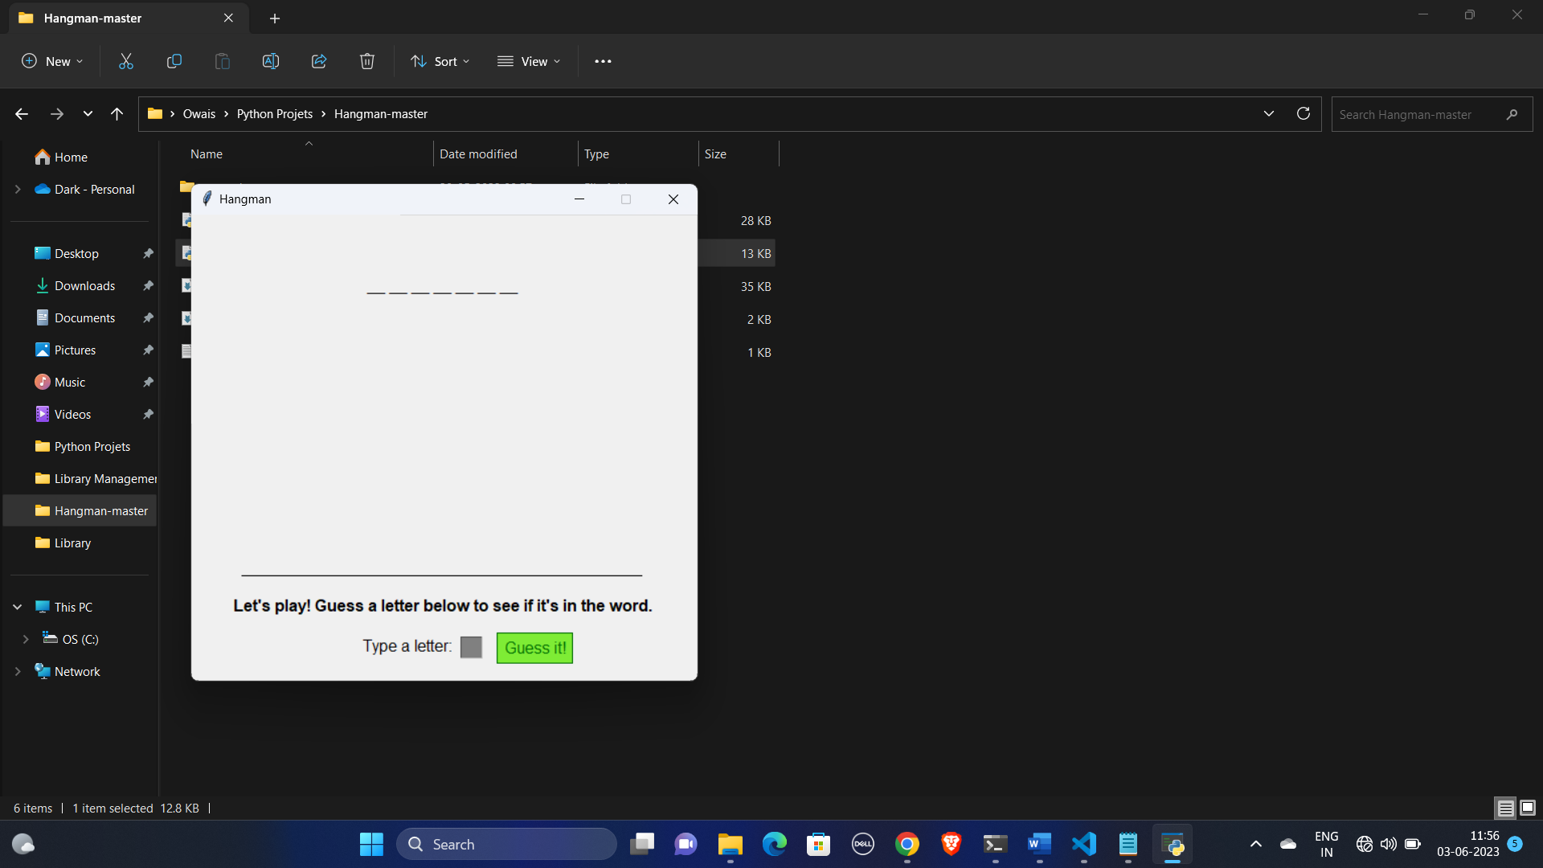
Some Pictures
To open Game

Slide 10
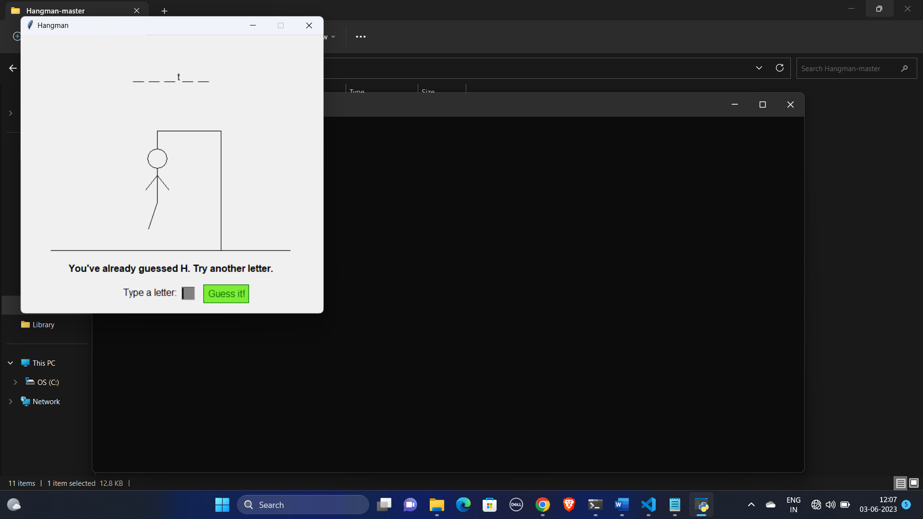
Guessing the Word

Slide 11

If the Word get Wrong

Slide 12
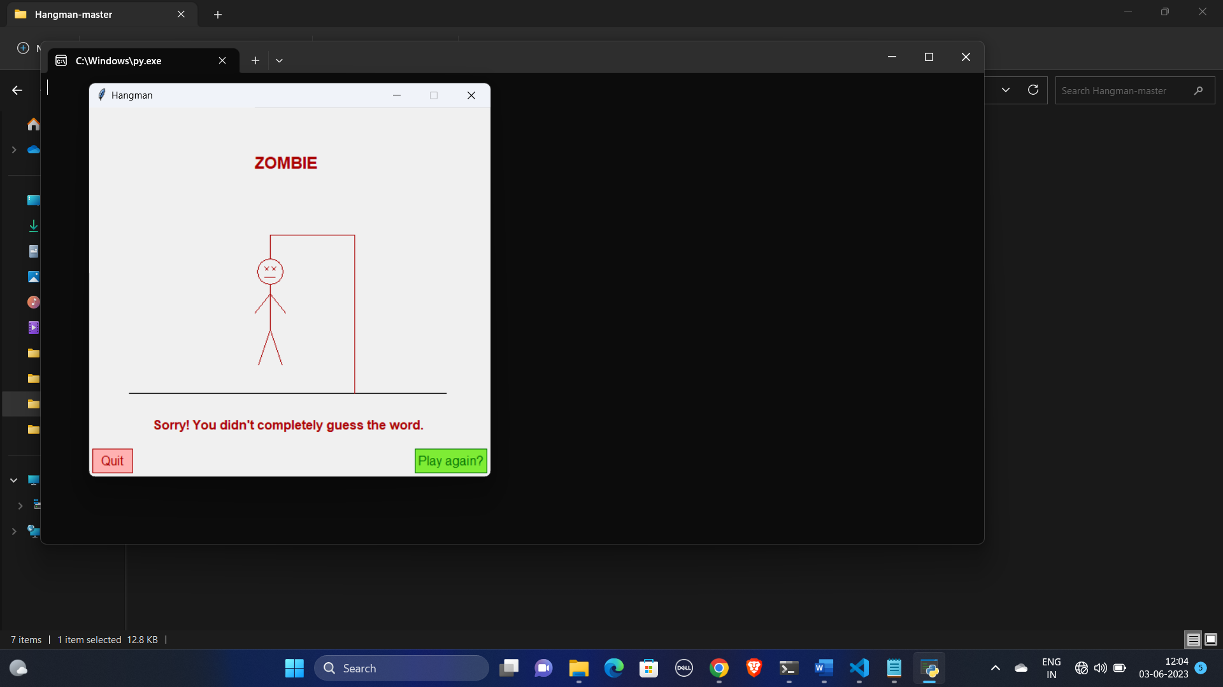
How Man Got Hang When the Word Guess Wrong

Slide 13
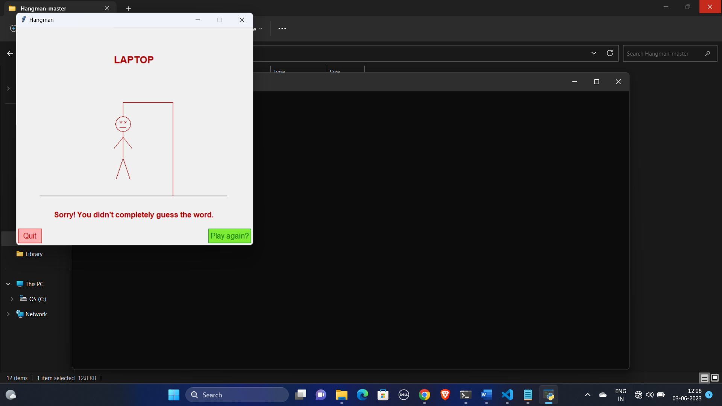
When the Guess Get Wrong

Slide 14
APPLICATIONS
It can perform different tasks like…
Language Learning
Teaching Tool
Mobile and Casual Gaming
Brain Training and Mental Stimulation
Rehabilitation and Therapy

Slide 15
FUTURE SCOPE
The scope of the project includes that what all future enhancement can be done in this system to make it more feasible to users
As technology advances, Hangman games can benefit from more visually appealing graphics and animations.
This feature would provide a more natural and interactive gameplay experience, especially for mobile devices
Implementing AR (Augmented Reality)technology can bring the Hangman game into the real world.

Slide 16
Advantages
Vocabulary Development
Spelling Practice
Critical Thinking and Problem-Solving
Entertainment and Engagement
Accessibility and Simplicity
Educational Value

Slide 17
CONCLUSION
Thus , the system is technologically more reliable & feasible than the existing system .We have got the opportunity to learn many things with the system . We do sincerely believe that we have been able to achieve the objectives & provide the ultimate output called “ User Satisfaction ” . This practical work really give us a chance to learn something different from typical reference books .

Slide 18
REFERENCE
Python WIKI…
https://en.m.wikipedia.org/wiki/Python_(programming_language)
THEORY….
https://www.w3schools.com/
INFORMATION ABOUT DESKTOP VOICE ASSISTANT…
https://www.studocu.com

